Slide 1
EGE PRACTICAL EXAM
TITLE: ORTHOGRAPHIC PROJECTION/VIEW
NAME: ABDURRAHMAN QURESHI
ROLL NO: 210451

Slide 2
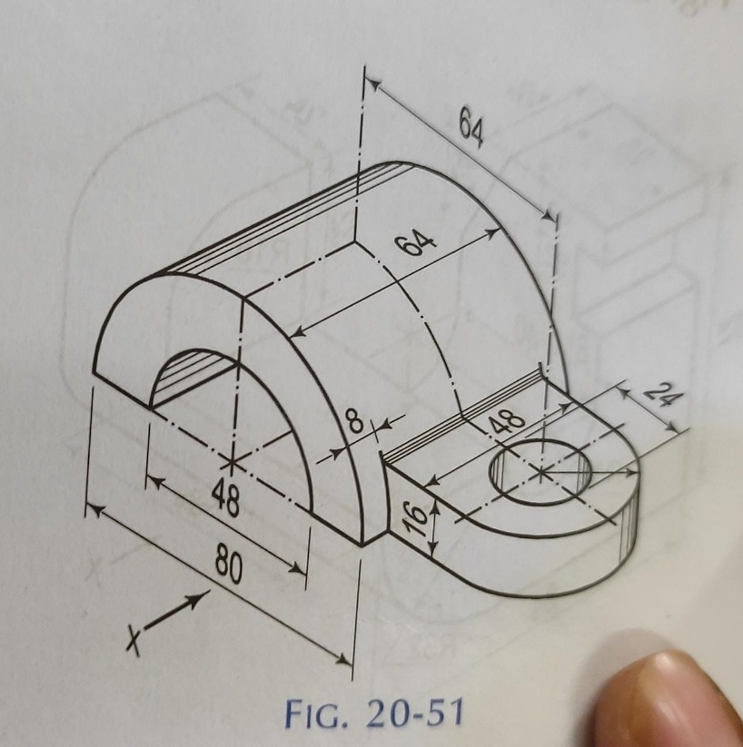
QUESTION: DRAW THE ORTHOGRAPHIC PROJECTION/VIEW FOR THE GIVEN DIAGRAM

Slide 3
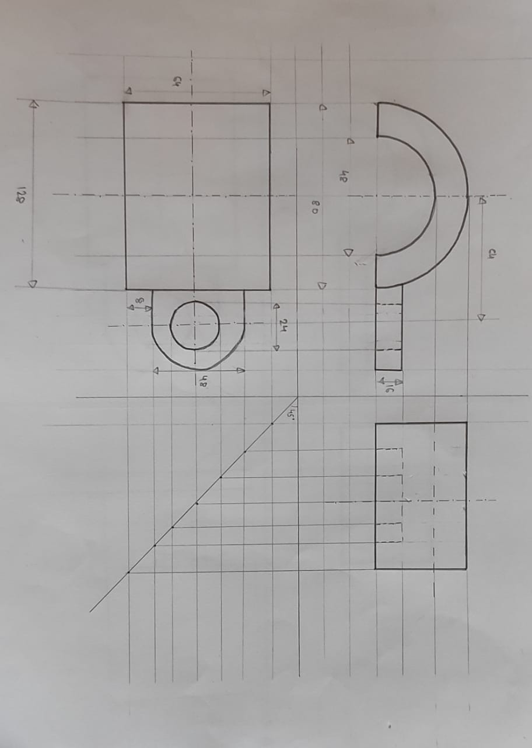
Final answer:

